Slide 1

Saving Sensodyne
Team 2 | Section 001
Kunal Pathak, Shiva Kammala, Amit Parikh
Sanjeev Musuvathy, Olivia Bettis, Ira Chandramouli

Slide 2
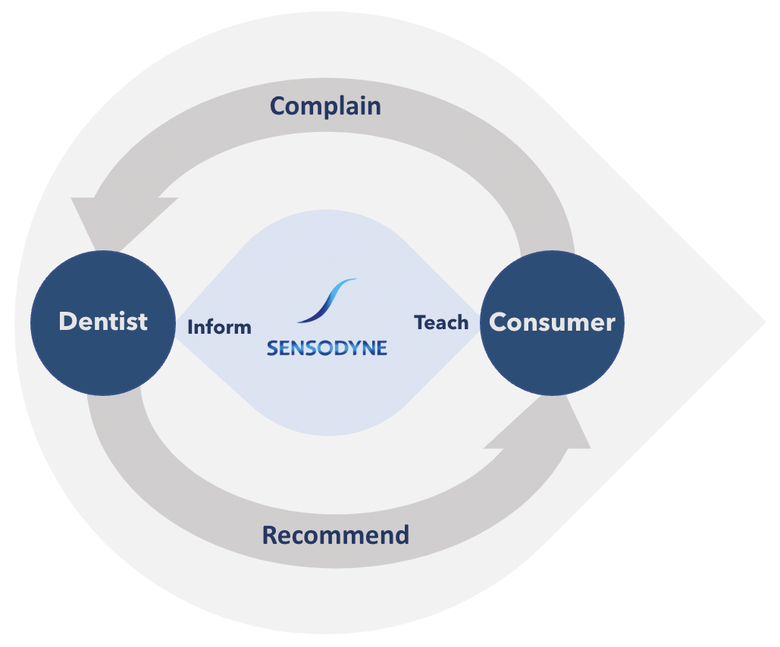
Sensodyne has established themselves as a brand that conveys trust and expertise
Marketing Approach
Background
Purchase
In the beginning, small player in niche market
Consumer Stores
Marketing shift prioritizing education
Retail Pharmacies
Invest heavily in R&D
Online E-Commerce
Differentiate themselves as a premium provider
The pandemic has reshaped the way people view everyday shopping. Today, more people are shopping online for oral care than ever before.
#1 provider in a sector holding 20% of the market
Source: Marketing Society, Markets and Markets
Notes:
Olivia
https://www.marketingsociety.com/sites/default/files/thelibrary/Sensodyne%20-%20How%20marketing%20created%20a%20billion%20dollar%20brand.pdf
https://www.marketsandmarkets.com/Market-Reports/oral-care-market-80546246.html

Slide 3
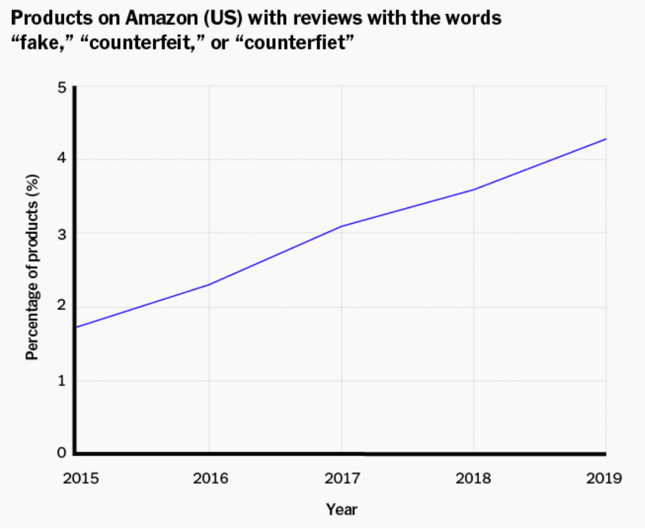
The rise of e-commerce sites, such as Amazon, have given counterfeiters access to more consumers than ever before
$2 trillion
70%
Trillion
Industry
Of goods
sold in US
10 billion
2 million
Counterfeit
listings in 2020
Fake goods
destroyed
Amazon's group sourcing and unwillingness to audit providers is costing countless brands their public perception and forcing major companies such as Nike and Birkenstock to end their partnership
Source: Forbes, Fast Company, New York Times
Notes:
Olivia
https://www.forbes.com/sites/forbesbusinesscouncil/2022/08/02/the-global-impact-of-counterfeiting-and-solutions-to-stop-it/?sh=329d74771ca2
https://www.fastcompany.com/90636859/the-volume-of-the-problem-is-astonishing-amazons-battle-against-fakes-may-be-too-little-too-late
https://www.forbes.com/sites/wadeshepard/2017/12/13/how-to-protect-your-family-from-dangerous-fakes-on-amazon-this-holiday-season/?sh=7759e5427cf1
https://corsearch.com/content-library/blog/how-counterfeit-goods-are-destroying-brand-reputation/
https://www.nytimes.com/wirecutter/blog/amazon-counterfeit-fake-products/

Slide 4
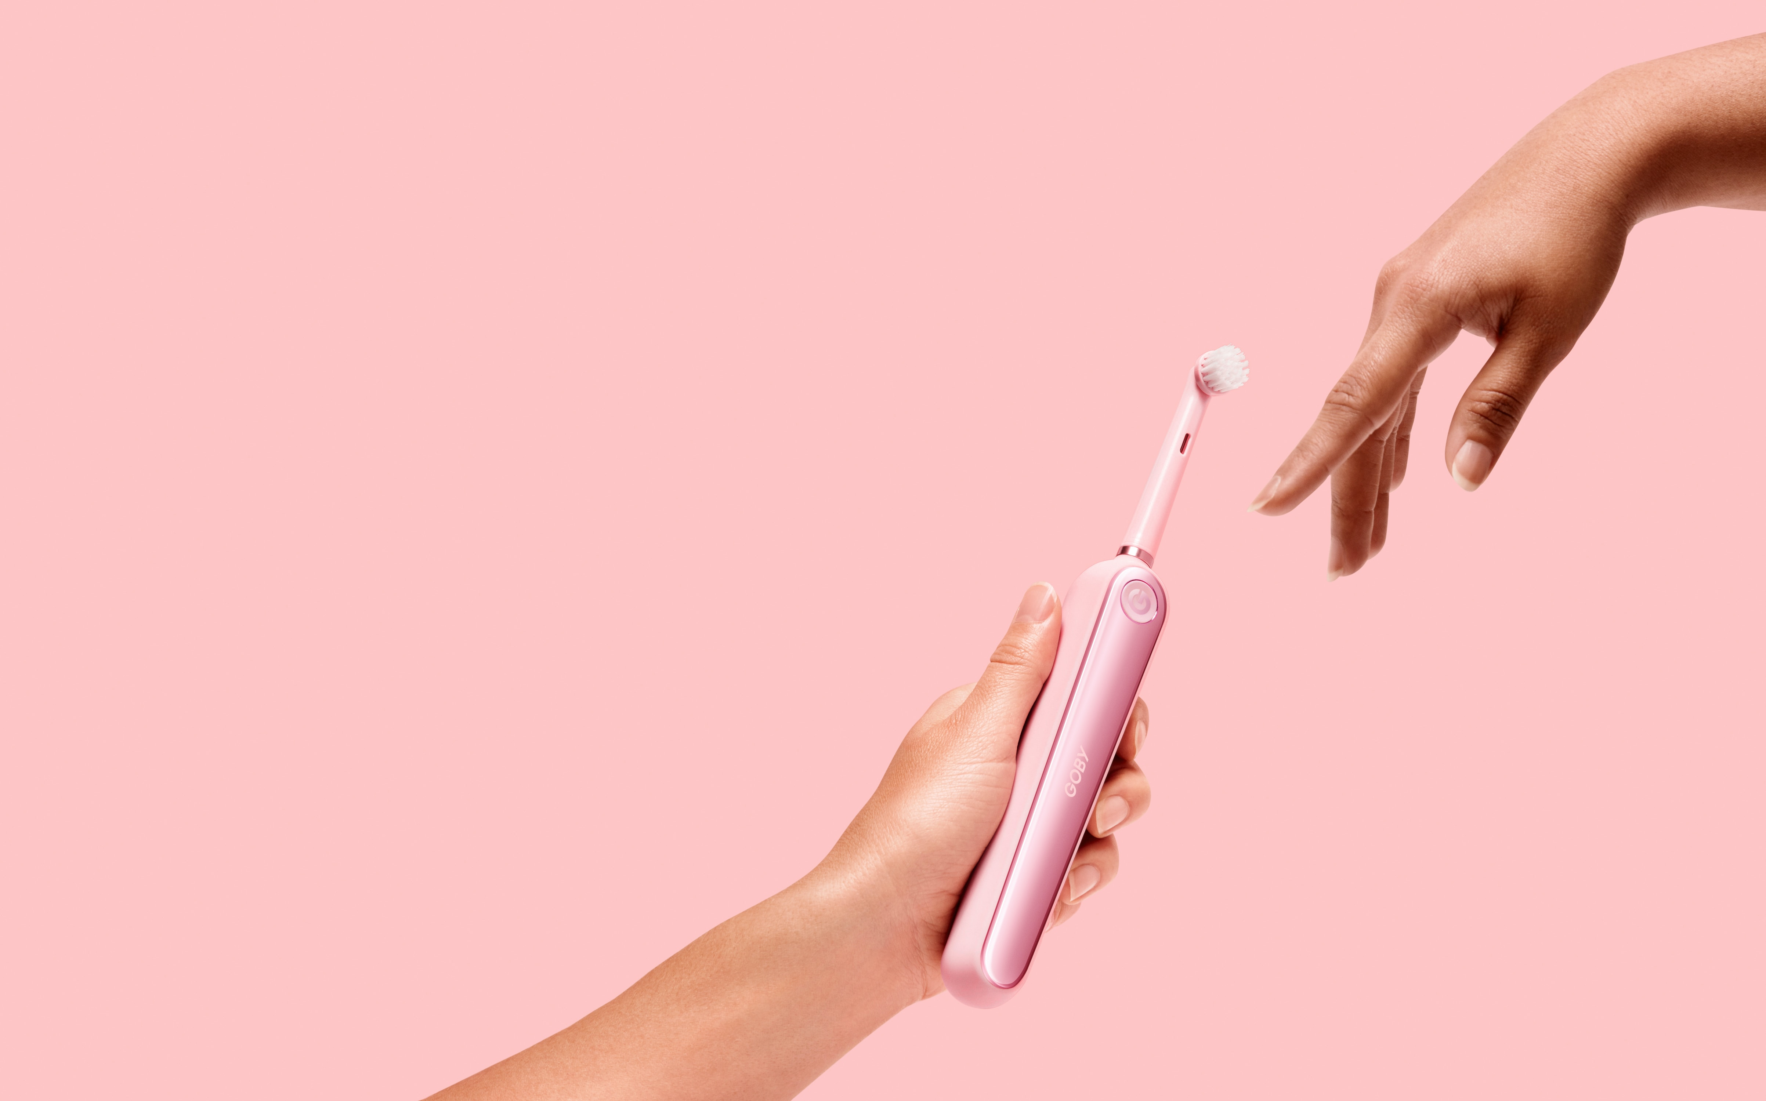
Does Amazon counterfeiting pose a financial
and brand risk to Sensodyne?
Notes:
IRA

Slide 5
The brand and financial challenges are immense for Sensodyne
228K customers, representing 1.68M revenue are at risk
72%
Multiplying Factors Illustrates Risk
Of parents would stop buying a product if they knew fakes were on the market
$195M Revenue from Toothpaste
~30% Amazon Channel Revenue
$7.5 Average Selling Price
36%
Of parents said they would switch to a competing brand to avoid counterfeits
0.3% Counterfeit Rate
220K
Customers at Risk
Source: US Census Bureau, Forbes, Washington Post
Notes:
Sanjeev
First, we did a market analysis to see whether there is a significant risk....
Sensodyne roughly 200M dollars, 95% revenue from toothpastes as it looks like only 1 SKU of toothbrush. 0.3% rate of counterfeit means that 5.7M revenue at risk. Roughly 760K units are at risk if we aggregate this rate globally, but that’s not true because not all volume is off amazon. E-commerce sales in 2021 (census bureau) were 14.6% of total, so can assume maybe double because this is a general consumer product at 30%. So 228K total customers at risk.
o 2 out of 3 parents they surveyed were aware that fake products can be hazardous, "since they are not regulated for health and safety standards." 72% of these same parents claimed that they would outright stop buying a product if they became aware that counterfeits of it were in the market and 36% responded that they would switch to a competing brand if there was a reasonable chance they could end up with a fake

Slide 6
Our robust data analytics process enabled us to gain deep insights
1
2
3
4
5
6
Data
Collection
Initial
Exploration
Data
Generation
Build
Model
Test
Model
Analyze
Results
Notes:
Amit
As Sanjeev started getting into, we wanted to validate the scale of this issue for Sensodyne using different data science techniques. To give some context for the results of our analysis we'll briefly walk through our analytical process and some of the unique steps we took.
Data Collection
We started by collecting ~16,000 Sensodyne product reviews from different listings on Amazon using an Apify scraper.
Initial Exploration
We clustered the negative reviews and found counterfeit products to be a significant issue
Generate Data, Build Model, Test Model
We used ChatGPT to generate training data and used this to build a model that could classify which negative reviews pertained to counterfeit products. We tested this on real review data that we manually labeled.
Analyze Results
Finally we applied our classifier to all the negative Amazon reviews that we had pulled from Apify and used this to analyze the issue. Kunal will talk more about some of this analysis.

Slide 7
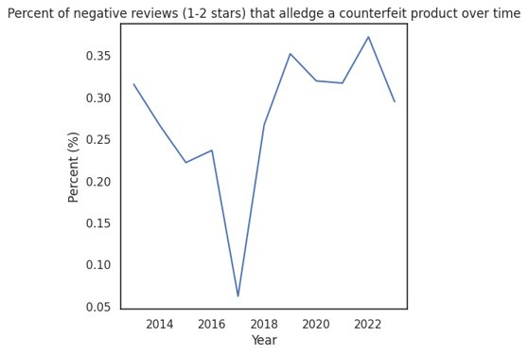
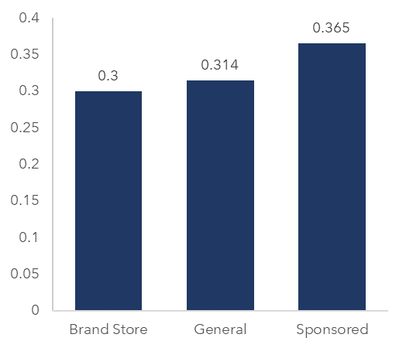
There are substantial levels of fake reviews, and these have grown since 2017
% of Counterfeit Reviews on Channel
18% Increase
Source: Team Data
Notes:
Kunal
We looked at the percent of negative reviews that alledged a counterfeit review over time. We found that in recent years, the problem has been as high as ever and hasn't showed that it is declining at all.
The percentage has hovered over 30% which showed us that this problem is extremely relevant for Sensodyne.
Next we broke down the percent of counterfeit reviews by the type of listing that they were under.
There are 3 types of listings we identified
Sponsored listings – the seller of these products has paid to promote the product in search results. These types of listings had the highest percent of counterfeit reviews.
Brand Storefront listings – these are listings on the Sensodyne Amazon storefront. Counterfeit products can still get mixed in but they had the lowest percent of reviews.
General listings – these were the normal listings on Amazon. These had a relatively high percent of counterfeit reviews.
Overall, the counterfeit problem is prevalent among all listing types and Sensodyne needs a solution.

Slide 8
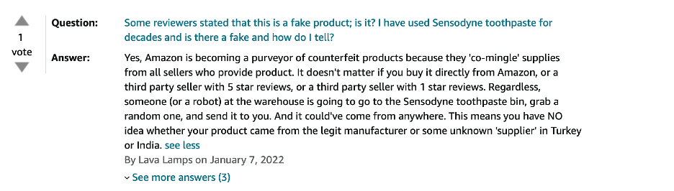

How does that play into the role that Amazon reviews take for our consumers?
93%
88%
of Millennials rely on consumer reviews before making a purchase
of Millennials equivalate online reviews to personal recommendations
Source: Weave, Amazon 1P Review Data
Notes:
Shiva
Message from Weave (getweave.com)
Individual reviews further validate our concern -

Slide 9
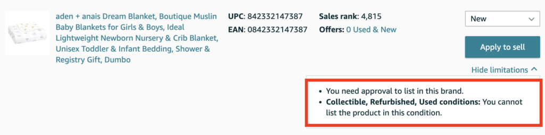
Making Sensodyne a restricted brand enables strong potential for growth
Approve Select 3P Distributors
Sponsor Official Postings
Expand D2C Walmart Partnership
Source: Weave
Notes:
Sanjeev
Potential risk we could as is this may lead to higher fees and longer delivery times might lead to customers reverting to random 3rd party vendors that pop up

Slide 10
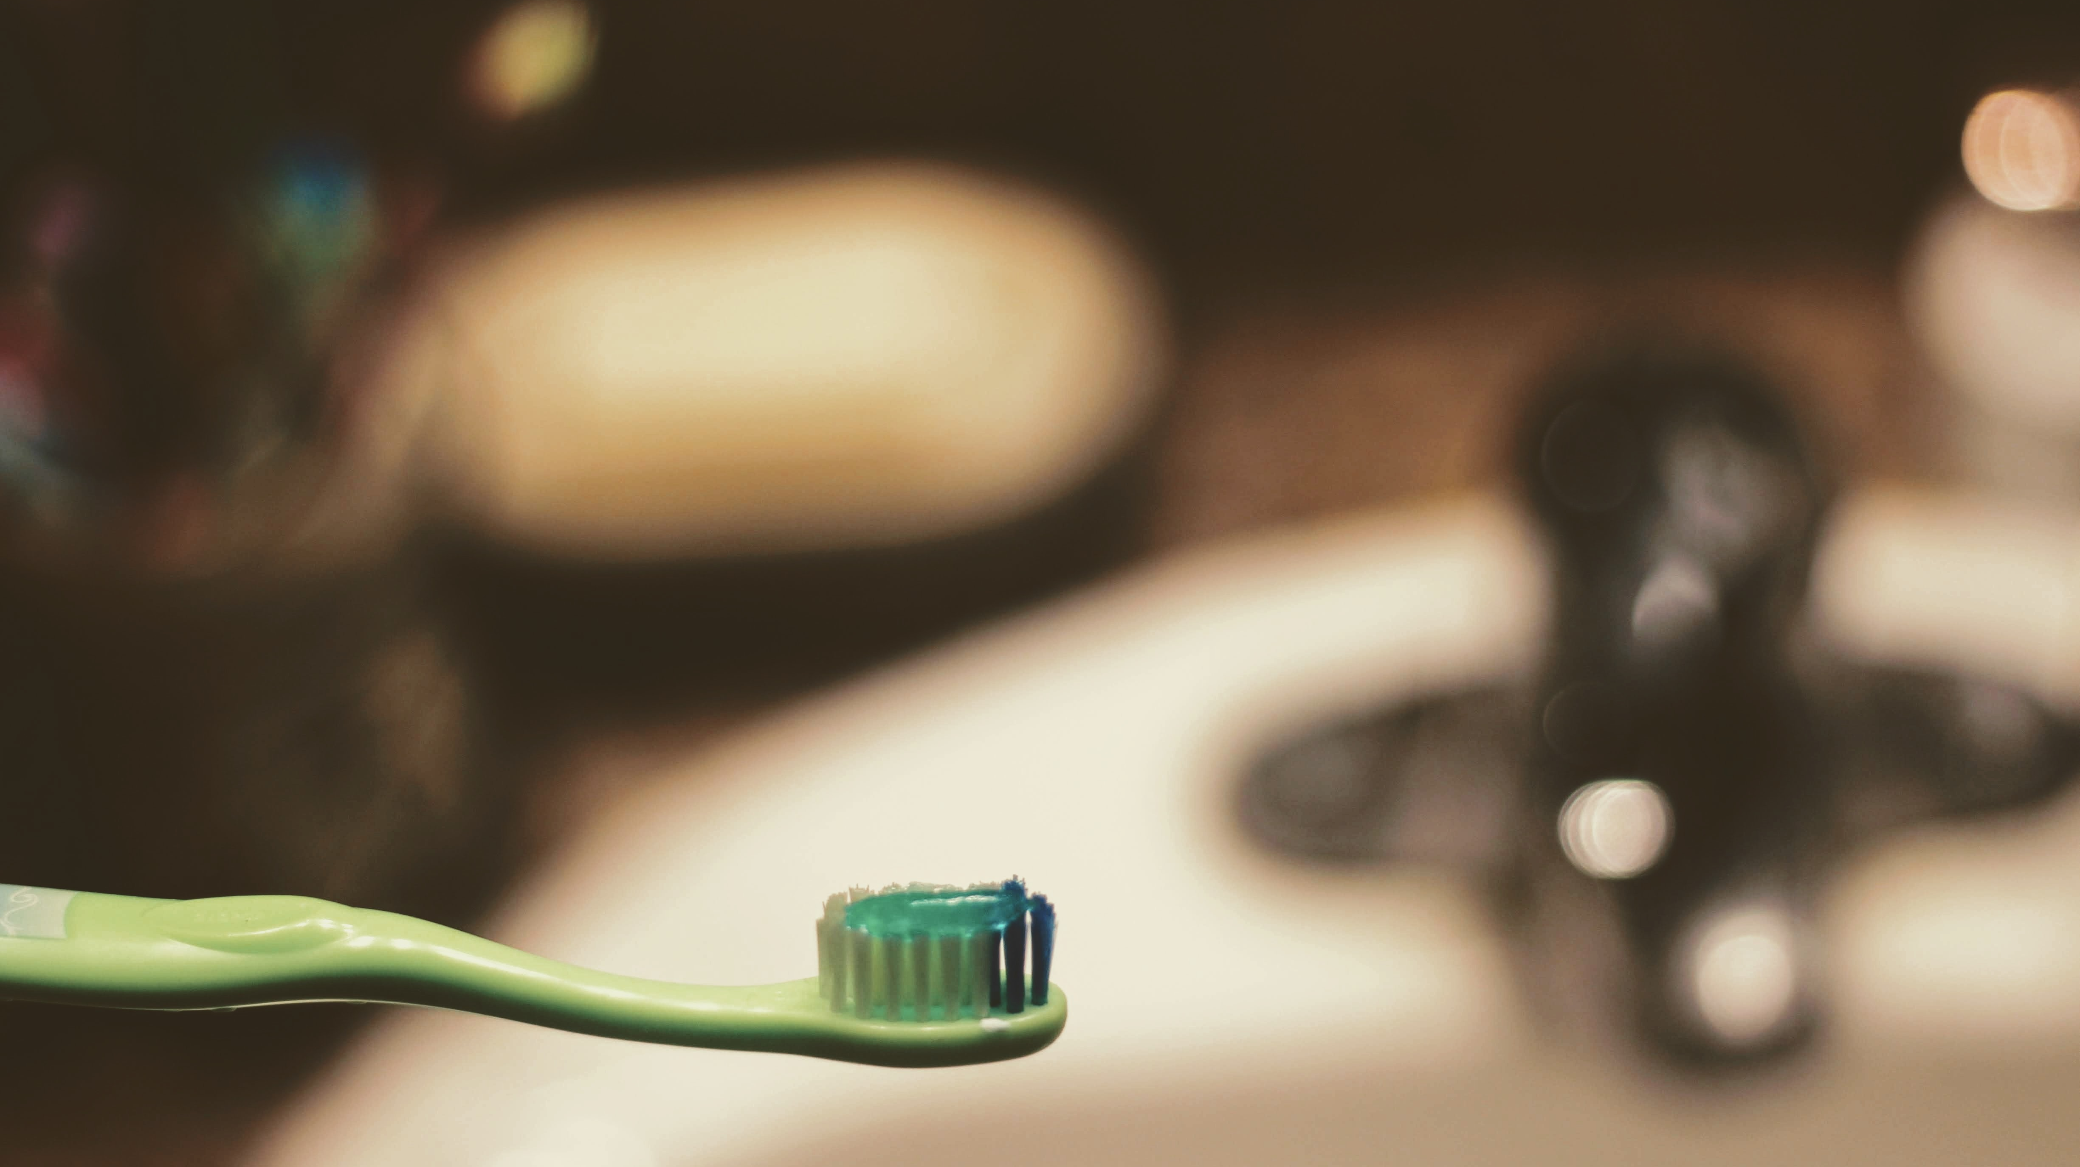
Thank you! Questions?
Notes:
Change picture

Slide 11
Appendix

Slide 12
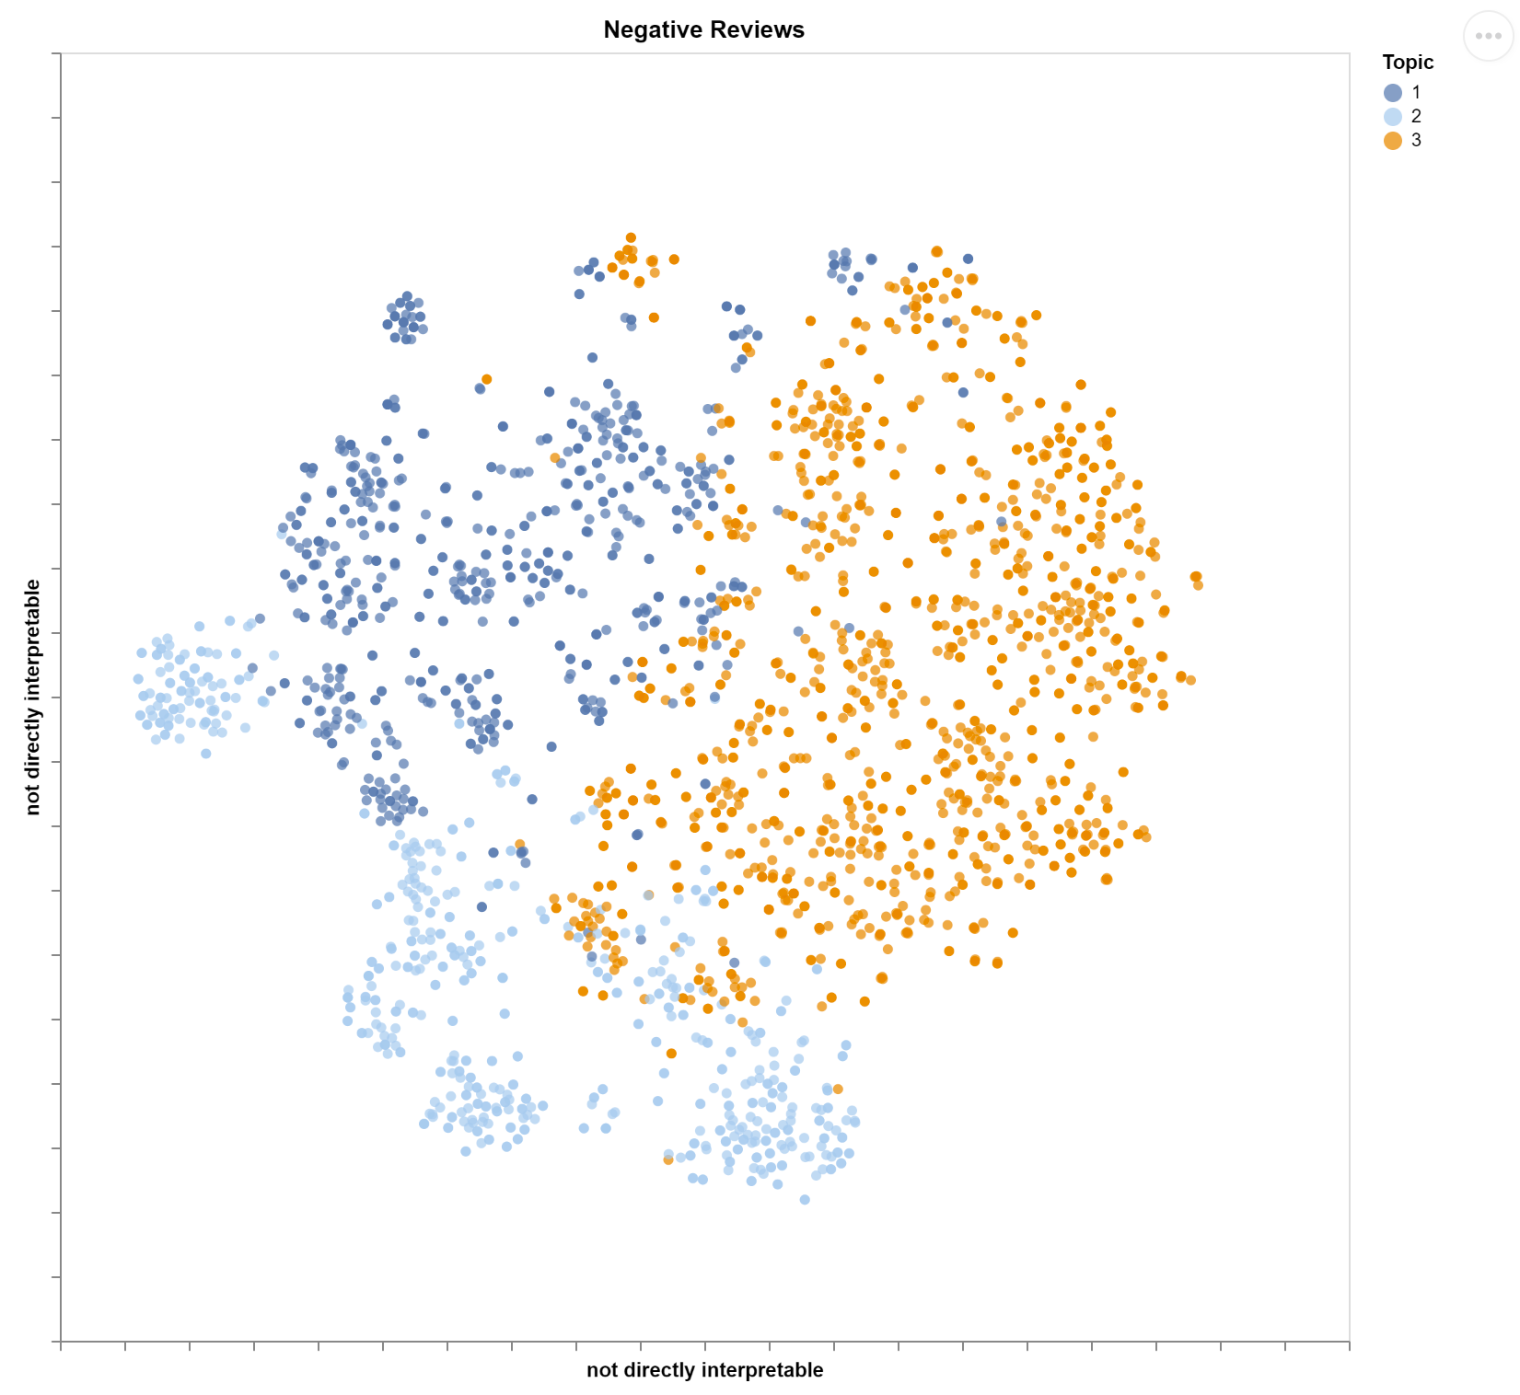
Appendix #1
We clustered the 1-2 star reviews of Sensodyne products into 3 groups. Topic 1 primarily consists of reviews that allege counterfeit products.

Slide 13
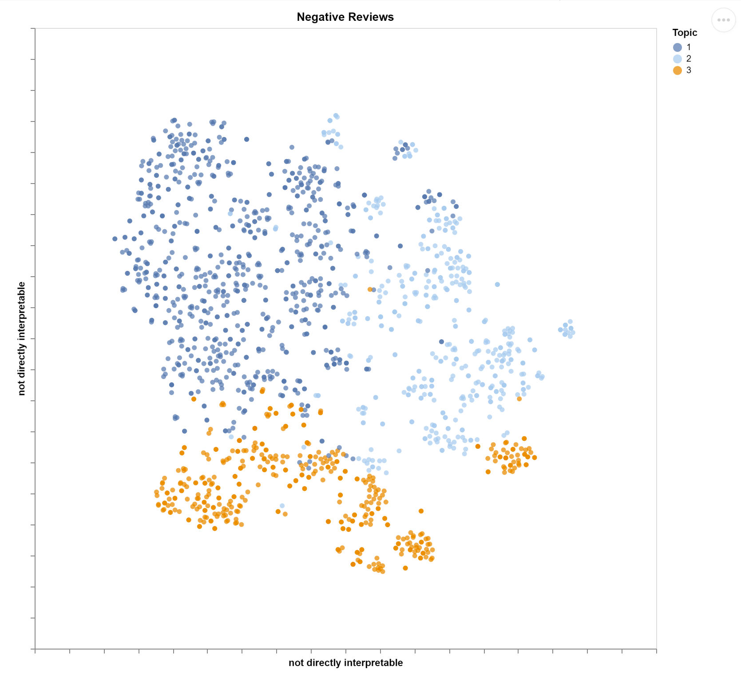
Appendix #2
We clustered the 1-2 star reviews that did not allege counterfeit products. Topic 2 primarily consists of reviews mentioning terrible taste.
This could be a problem with Sensodyne's product OR it could be that customers are unknowingly getting counterfeit products.

Slide 14
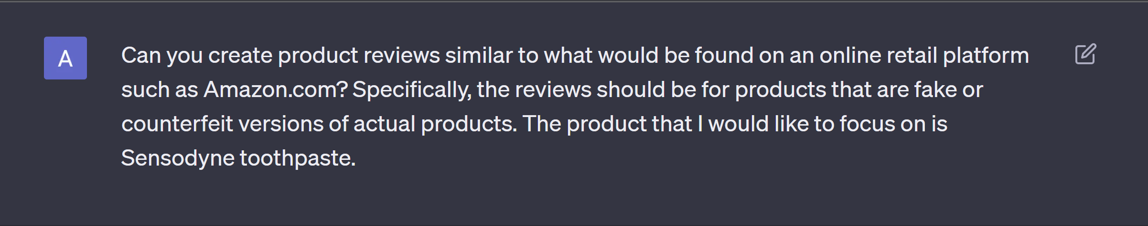
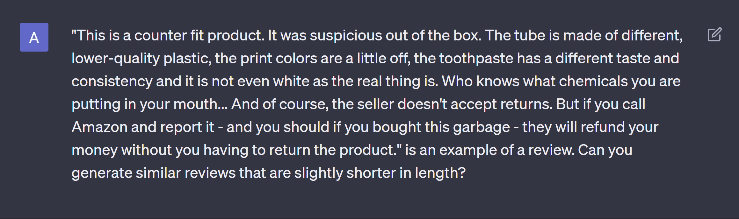
Appendix #3
These are some of the prompts we used to generate training reviews from ChatGPT:

Slide 15
Space for Dr. D’s Notes
Notes:
Change picture

